Slide 1
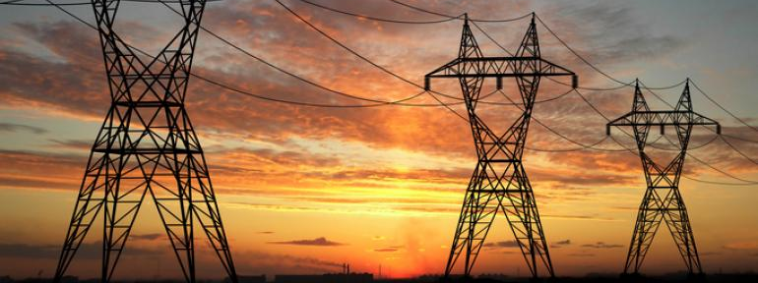
Electricity Load Forecasting for Austin, TX
Spandan Gandhi, Harrison Van Til

Slide 2

Overview
Help utilities determine the future consumption of electricity
Make economically viable decisions and reduce risk in terms of future generation and transmission investments
Determine amount of various sources like fuels, to ensure uninterrupted supply of electricity and yet avoid overstocking. This is important for short, medium and long term forecasting.
Helps determine size, location and type of future generating plant, and help minimize transmissions and distribution infrastructures as well as associated losses.
Helps scheduling in maintenance of power systems, ensuring minimum impact on customers.
Helps avoid over-generation of electricity.
Data Collection
Analysis/ML
Insights
Exploration/ Visualization
Data Processing

Slide 3
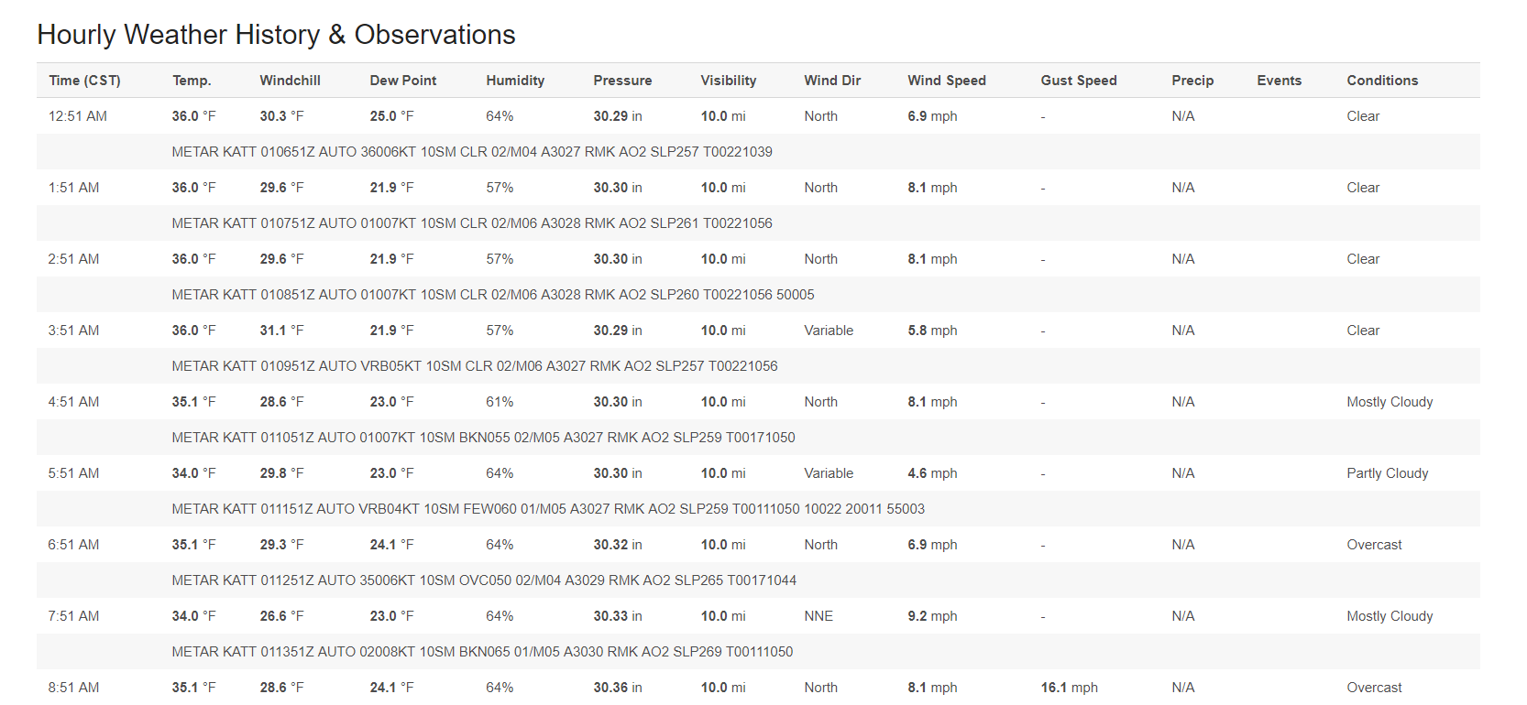
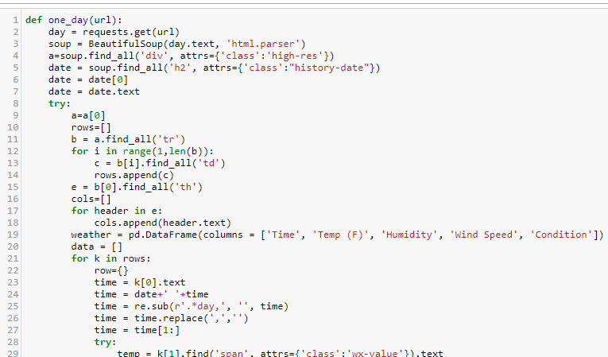
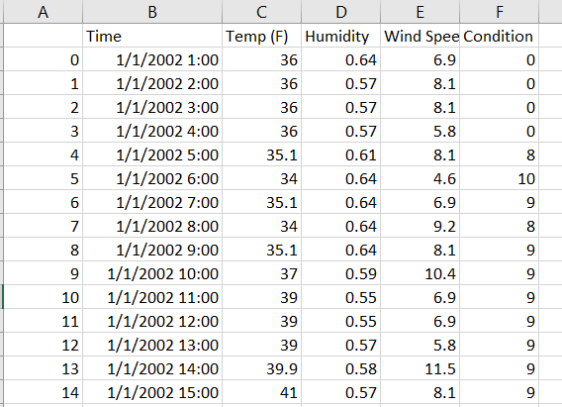
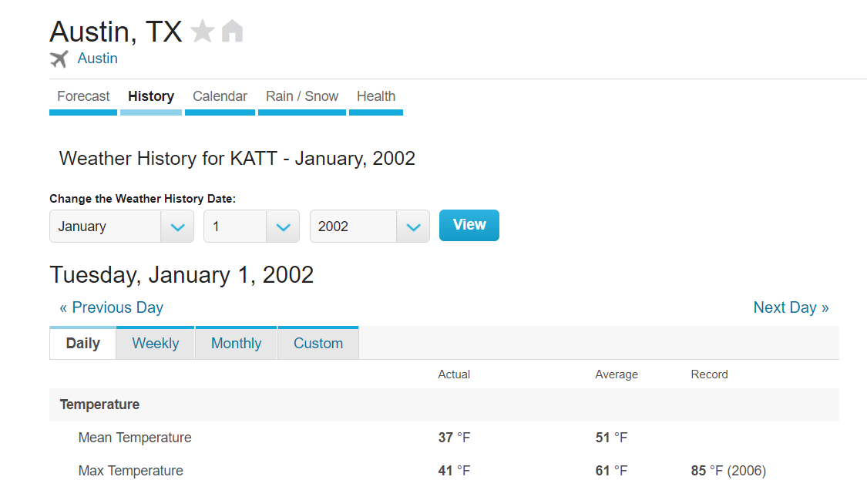
Data Collection

Slide 4
SARIMA Model

Slide 5
Linear Regression Model

Slide 6
Linear Regression with Gradient Boosting

Slide 7
Neural Networks

Slide 8
Prediction Results

